Slide 1
CS 484
Introduction to Machine Learning
Week 6, February 25, 2021
Spring Semester 2021

Slide 2
Week 6: Logistic Regression
Multinomial Logistic Regression
Forward and Backward Selection
All Possible Selection
Chapter 6 of the Machine Learning book

Slide 3
Rule-Based vs. Parametric Classification Model
Decision Tree is a Rule-Based Model
Use rules to divide observations into disjoint segments
Use empirical proportions of the target categories as predicted probabilities
Logistic Regression is a Parametric Model
Use a formula to calculate the predicted probabilities
Can do sensitive study to understand impacts to model outcomes when a predictor change values

Slide 4
Logistic Regression Model
In a nutshell, a logistic model relates the probability that a target category will occur as a linear function of the predictors
Domain: $u∈ℝ$ (the real number line)
Domain: 𝑢∈ℝ (the real number line)
Range: $0≤f\left(u\right)≤1$
Range: 0≤𝑓(𝑢)≤1
Trend: when $u$ increases, so does $f\left(u\right)$
Trend: when 𝑢 increases, so does 𝑓(𝑢)
$$u=b_{0}+\sum_{i=1}^{k}{b_{i}x_{i}}$$
𝑢=𝑏_0+∑2_(𝑖=1)^𝑘▒〖𝑏_𝑖 𝑥_𝑖 〗
$Pr\left(Y=y\right)=f\left(u\right)$
Pr(𝑌=𝑦)=𝑓(𝑢)

Slide 5
Three Types of Logistic Model
Type of Logistic Model | Type of Target Variable | Example of Target Variable
Binary Logistic Model | Binary Categorical Two unique values | Loan Default: No Yes
Multinomial Logistic Model | Nominal Categorical Any number of unique values | US credit card network: American Express Discover MasterCard Visa
Ordinal Logistic Model | Ordinal Categorical Any number of unique values Explicit numerical, lexical, or contextual order among values | FICO score range (300 to 850): Deep Subprime (< 580) Subprime (580 – 619) Near Prime (620 – 659) Prime (660 – 719) Superprime (≥ 720)
FICO: Fair Isaac Corporation

Slide 6
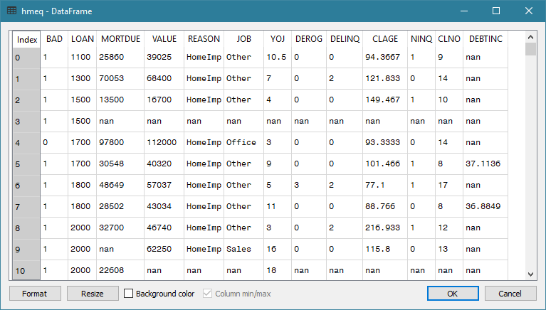
Multinomial Logistic (MNL): Data
Since BAD is 0 or 1, how can I observe the occurrence likelihood of a BAD loan?
What if I look at groups of observations by predictor values?

Slide 7
Multinomial Logistic (MNL): Strategy
Group the observations by values of the predictors for consideration
Count the occurrences (i.e., the frequencies) of the target categories in each group
Analyze how the predictor values influence the relative frequencies of the target categories

Slide 8
MNL: Subpopulation
Example
Home equity loan data: hmeq.csv
BAD: Loan in default (0=No, 1=Yes), binary
REASON: Reason for getting the loan, (DebtCon=debt consolidation, HomeImp=home improvement), categorical
JOB: Job type (Mgr=manager, Office=office worker, Other=others, ProfExe=professional or executive, Sales=sales profession, Self=self employed), categorical
DEROG: The number of derogatory inquiries (0+), interval
Target
Predictor

Slide 9
MNL: Subpopulation
Percent Table:
BAD 0 1 All
REASON
DebtCon 81.033605 18.966395 100.0
HomeImp 77.752809 22.247191 100.0
All 80.010512 19.989488 100.0
Group by REASON
REASON = DebtCon, the likelihood of BAD = 1 is 18.966395 / 19.989488 = 0.95 times of the overall
REASON = HomeImp, the likelihood of BAD = 1 is 22.247191 / 19.989488 = 1.11 times of the overall
Group by JOB
JOB = Office, the likelihood of BAD = 1 is 13.185654 / 20.524556 = 0.64 times of the overall
JOB = Self, the likelihood of BAD = 1 is 30.051813 / 20.524556 = 1.46 times of the overall
Question: Why the marginal BAD=1 percents are different between REASON and JOB?
Percent Table:
BAD 0 1 All
JOB
Mgr 76.662321 23.337679 100.0
Office 86.814346 13.185654 100.0
Other 76.800670 23.199330 100.0
ProfExe 83.385580 16.614420 100.0
Sales 65.137615 34.862385 100.0
Self 69.948187 30.051813 100.0
All 79.475444 20.524556 100.0

Slide 10
MNL: Subpopulation
Group by REASON and JOB
REASON = HomeImp and JOB = Office The likelihood of BAD = 1 is 10.963455 / 20.375723 = 0.54 times Overall
REASON = DebtCon and JOB = Mgr or Other The likelihood of BAD = 1 is practically the same as the Overall
REASON = DebtCon and JOB = Self The likelihood of BAD = 1 is 43.835616 / 20.375723 = 2.2 times Overall
Percent Table:
BAD 0 1 All
REASON JOB
DebtCon Mgr 79.720280 20.279720 100.0
Office 85.161290 14.838710 100.0
Other 79.239401 20.760599 100.0
ProfExe 84.769776 15.230224 100.0
Sales 64.948454 35.051546 100.0
Self 56.164384 43.835616 100.0
HomeImp Mgr 67.816092 32.183908 100.0
Office 89.036545 10.963455 100.0
Other 71.368715 28.631285 100.0
ProfExe 81.975309 18.024691 100.0
Sales 66.666667 33.333333 100.0
Self 81.739130 18.260870 100.0
All 79.624277 20.375723 100.0

Slide 11
MNL: Subpopulation
Percent Table:
BAD 0 1 All
REASON JOB DEROG
DebtCon Mgr 0.0 82.425743 17.574257 100.0
1.0 68.965517 31.034483 100.0
2.0 40.909091 59.090909 100.0
3.0 0.000000 100.000000 100.0
4.0 0.000000 100.000000 100.0
7.0 0.000000 100.000000 100.0
8.0 0.000000 100.000000 100.0
Office 0.0 88.376754 11.623246 100.0
1.0 50.000000 50.000000 100.0
2.0 46.666667 53.333333 100.0
3.0 0.000000 100.000000 100.0
Other 0.0 81.712386 18.287614 100.0
1.0 57.692308 42.307692 100.0
2.0 65.957447 34.042553 100.0
3.0 50.000000 50.000000 100.0
4.0 71.428571 28.571429 100.0
5.0 100.000000 0.000000 100.0
6.0 62.500000 37.500000 100.0
7.0 0.000000 100.000000 100.0
8.0 0.000000 100.000000 100.0
9.0 0.000000 100.000000 100.0
10.0 0.000000 100.000000 100.0
ProfExe 0.0 87.352941 12.647059 100.0
1.0 76.923077 23.076923 100.0
2.0 37.500000 62.500000 100.0
3.0 22.222222 77.777778 100.0
4.0 0.000000 100.000000 100.0
6.0 0.000000 100.000000 100.0
7.0 0.000000 100.000000 100.0
Sales 0.0 72.000000 28.000000 100.0
... ... ...
All 78.939972 21.060028 100.0
How should we handle the interval predictors?
Although DEROG is an interval variable, it is treated as a categorical variable only for the purpose of aggregation

Slide 12
MNL: Subpopulation
Subpopulations are defined by the observed cross-classifications of distinct values of predictors (i.e., input features).
For example, if REASON (categorical), JOB (categorical), DEROG (interval) are predictors, then examples of subpopulations are:
Reason = DebtCon, JOB = Mgr, and DEROG=0
REASON = DebtCon, JOB = ProfExe, and DEROG=6
REASON = HomeImp, JOB = Office, DEROG=2
Subpopulations are user-defined disjoint partitions of the data

Slide 13
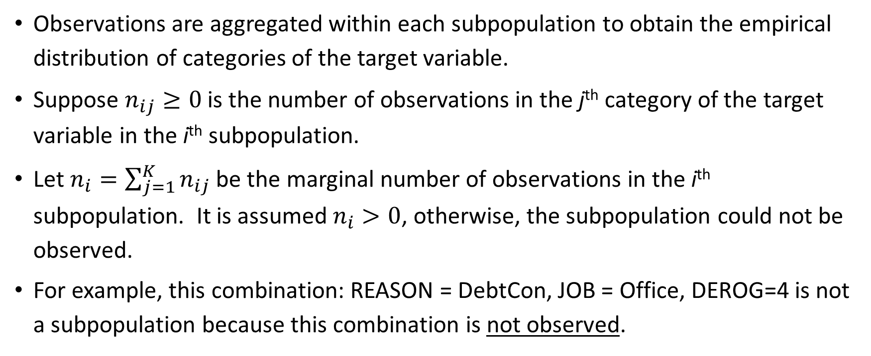
MNL: Subpopulation
Observations are aggregated within each subpopulation to obtain the empirical distribution of categories of the target variable.
Suppose $n_{ij}≥0$ is the number of observations in the j^{th} category of the target variable in the i^{th} subpopulation.
Let $n_{i}=\sum_{j=1}^{K}{n_{ij}}$ be the marginal number of observations in the i^{th} subpopulation. It is assumed $n_{i}>0$, otherwise, the subpopulation could not be observed.
For example, this combination: REASON = DebtCon, JOB = Office, DEROG=4 is not a subpopulation because this combination is not observed.

Slide 14
MNL: Parameter Coding for Categorical Predictor
The dummy coding (a.k.a. GLM or over-parametrized coding) is to create a binary column whose values are: 0 or 1 for each category of a categorical predictor.
The pandas.get_dummies() function can generate dummy columns
MNL does not distinguish between nominal and ordinal predictors, both types are considered as categorical predictors.
If the categorical predictor has p categories, then p binary dummy columns are created.

Slide 15
MNL: Parameter Coding for Categorical Predictor
REASON has two categories. The two binary columns are:
REASON_Debtcon = 1 if REASON = ‘DebtCon’, 0 otherwise
REASON_HomeImp = 1 if REASON = ‘HomeImp’, 0 otherwise.
JOB has six categories. The six binary columns are:
JOB_Mgr = 1 if JOB = ‘Mgr’, 0 otherwise
JOB_Office = 1 if JOB = ‘Office’, 0 otherwise
JOB_Other = 1 if JOB = ‘Other’, 0 otherwise
JOB_ProfExe = 1 if JOB = ‘ProfExe’, 0 otherwise
JOB_Sales = 1 if JOB = ‘Sales’, 0 otherwise
JOB_Self = 1 if JOB = ‘Self’, 0 otherwise

Slide 16
MNL: Covariate Pattern
A covariate pattern is the set of variable values that correspond to a subpopulation.
Let $x_{i}$ be the $p×1$ column vector that contains values of a covariate pattern
Categorical predictor: use the Dummy Coding
1 to indicate the presence of a categorical value in current observation
0 otherwise
Continuous predictor: use the observed value as-is

Slide 17
MNL: Covariate Pattern
Subpopulation
Covariate Pattern
REASON | JOB | DEROG
DebtCon | Mgr | 0
REASON | JOB | DEROG
HomeImp | ProfExe | 6
REASON_DebtCon | REASON_HomeImp | JOB_Mgr | JOB_Office | JOB_Other | JOB_ProfExe | JOB_Sales | JOB_Self | DEROG
1 | 0 | 1 | 0 | 0 | 0 | 0 | 0 | 0
REASON_DebtCon | REASON_HomeImp | JOB_Mgr | JOB_Office | JOB_Other | JOB_ProfExe | JOB_Sales | JOB_Self | DEROG
0 | 1 | 0 | 0 | 0 | 1 | 0 | 0 | 6

Slide 18
MNL: Target Variable
If we observed the $ith$ subpopulation, then we must observe some categories of the target variable. Thus, we can assume that $π_{ij}>0$ for some $1≤j≤K$.
If we observed the 𝑖^{th} subpopulation, then we must observe some categories of the target variable. Thus, we can assume that 𝜋_𝑖𝑗>0 for some 1≤𝑗≤𝐾.
Let ${0≤π}_{ij}≤1$ be the probability that the $jth$ category of the target variable will be observed in the $ith$ subpopulation
Let 〖0≤𝜋〗_𝑖𝑗≤1 be the probability that the 𝑗^{th} category of the target variable will be observed in the 𝑖^{th} subpopulation
Let $K$ denotes number of target categories ($K≥2$)
Let 𝐾 denotes number of target categories (𝐾≥2)
Occurrences of the categories in each subpopulation follow a multinomial distribution
Require $\sum_{j=1}^{K}{π_{ij}}=1$
Require ∑_(𝑗=1)^𝐾▒𝜋_𝑖𝑗 =1
Distributions across subpopulations are independent

Slide 19
MNL: Parameters
Let $β_{j}$ be the $p×1$ column vector of parameters. Parameters are defined by [categories of] the predictors. One $β_{j}$ for each category of the target variable
Let 𝛃_𝑗 be the 𝑝×1 column vector of parameters. Parameters are defined by [categories of] the predictors. One 𝛃_𝑗 for each category of the target variable
Therefore, we arbitrarily set $β_{J}=0$ for the $J^{th}$ category (a.k.a. the reference category) of the target variable
Therefore, we arbitrarily set 𝛃_𝐽=0 for the 𝐽^th category (a.k.a. the reference category) of the target variable
The preferred choice is the MODE category (greatest number of observations)
A common choice is the LAST category (highest lexical order)
Since $\sum_{j=1}^{K}{π_{ij}}=1$, we only need $K−1$ parameter vectors
Since ∑_(𝑗=1)^𝐾▒𝜋_𝑖𝑗 =1, we only need 𝐾−1 parameter vectors
Choice of reference target category does not affect model goodness-of-fit

Slide 20
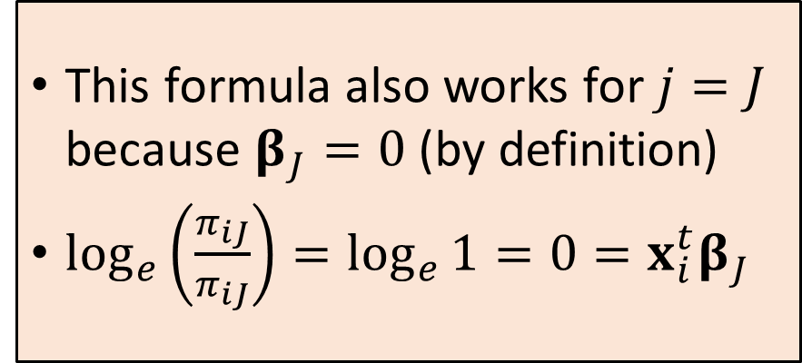
MNL: Theory
Logit: $\log_{e}\left(\frac{π_{ij}}{π_{iJ}}\right)$
Formula: $\log_{e}\left(\frac{π_{ij}}{π_{iJ}}\right)={x_{i}^{t}β}_{j}$ for $j=1,…,K$.
This formula also works for $j=J$ because $β_{J}=0$ (by definition)
$\log_{e}\left(\frac{π_{iJ}}{π_{iJ}}\right)=\log_{e}{1}=0={x_{i}^{t}β}_{J}$
The natural logarithm of the odds (or logit) of the $j^{th}$ category over the reference category is a linear combination of the parameters.

Slide 21
MNL: Theory
Equation: $\log_{e}\left(\frac{π_{ij}}{π_{iJ}}\right)={x_{i}^{T}β}_{j}$ is equivalent to $π_{ij}=π_{iJ}exp⁡\left({x_{i}^{T}β}_{j}\right)$
The sum of $π_{ij}$ over all $j=1,…,K$ gives $1=\sum_{j=1}^{K}{π_{ij}}=π_{iJ}\sum_{j=1}^{K}{exp⁡\left({x_{i}^{T}β}_{j}\right)}$
Therefore, $π_{iJ}=1/{\sum_{j=1}^{K}{exp⁡\left({x_{i}^{T}β}_{j}\right)}}$
Finally, $π_{ij}={exp⁡\left({x_{i}^{T}β}_{j}\right)}/{\sum_{l=1}^{K}{exp⁡\left({x_{i}^{T}β}_{l}\right)}}$ for $j=1,…,K$
The above formula also works for $j=J$ because of $\exp\left({x_{i}^{T}β}_{J}\right)=exp⁡\left(0\right)=1$.

Slide 22
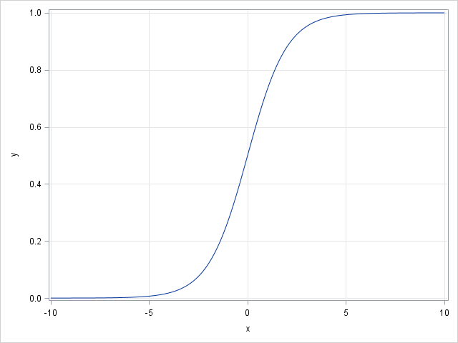
MNL: Why Logistic?
The logistic curve has the formula: $y=\frac{1}{1+e^{−x}}=\frac{e^{x}}{1+e^{x}}$ for any real x.
The range: $0≤y≤1$ for all values of $x$
It has two horizontal asymptotes:
$y=0$ as $x→−∞$ and
$y=1$ as $x→+∞$
In the middle portion of the domain, the curve appears approximately linear in $x$
Therefore, the curve is suitable for representing probability.

Slide 23
MNL: Maximum Likelihood Estimation (MLE)
We assume that the target categories in the $i^{th}$ subpopulation follow a multinomial distribution
The likelihood function is: $L=\prod_{i=1}^{m}{\left(\frac{n_{i}!}{\prod_{j=1}^{K}{n_{ij}!}}\prod_{j=1}^{K}{π_{ij}^{n_{ij}}}\right)}$ where $m$ is the number of subpopulations.
Take natural logarithm on both sides (logarithm of products = sums of logarithms)
Ignore this additive constant $\log_{e}\left(n_{i}!\right)−\sum_{j=1}^{K}{\log_{e}\left(n_{ij}!\right)}$
The log-likelihood function is $l=\sum_{i=1}^{m}{\sum_{j=1}^{K}{n_{ij}\log_{e}\left(π_{ij}\right)}}$

Slide 24
MNL: The Log-Likelihood Function
The log-likelihood function is a function of the betas:
$$l=\sum_{i=1}^{m}{\sum_{j=1}^{K}{n_{ij}\log_{e}\left(π_{ij}\right)}}=\sum_{i=1}^{m}{\sum_{j=1}^{K}{n_{ij}\log_{e}\left({exp⁡\left({x_{i}^{T}β}_{j}\right)}/{\sum_{l=1}^{K}{exp⁡\left({x_{i}^{T}β}_{l}\right)}}\right)}}$$
For the sake of discussion, let us set the last target category as reference, i.e., $J=K$.

Slide 25
MNL: The Log-Likelihood Function
The log-likelihood function is actually a function of the betas:
$$l=\sum_{i=1}^{m}{\sum_{j=1}^{K}{n_{ij}\log_{e}\left(π_{ij}\right)}}=\sum_{i=1}^{m}{\sum_{j=1}^{K}{n_{ij}\log_{e}\left({exp⁡\left({x_{i}^{T}β}_{j}\right)}/{\left(1+\sum_{l=1}^{K−1}{exp⁡\left({x_{i}^{T}β}_{l}\right)}\right)}\right)}}$$
$$=\sum_{i=1}^{m}{\sum_{j=1}^{K−1}{n_{ij}{x_{i}^{T}β}_{j}−}\sum_{i=1}^{m}{n_{i}\log_{e}\left(1+\sum_{l=1}^{K−1}{exp⁡\left({x_{i}^{T}β}_{l}\right)}\right)}}$$

Slide 26
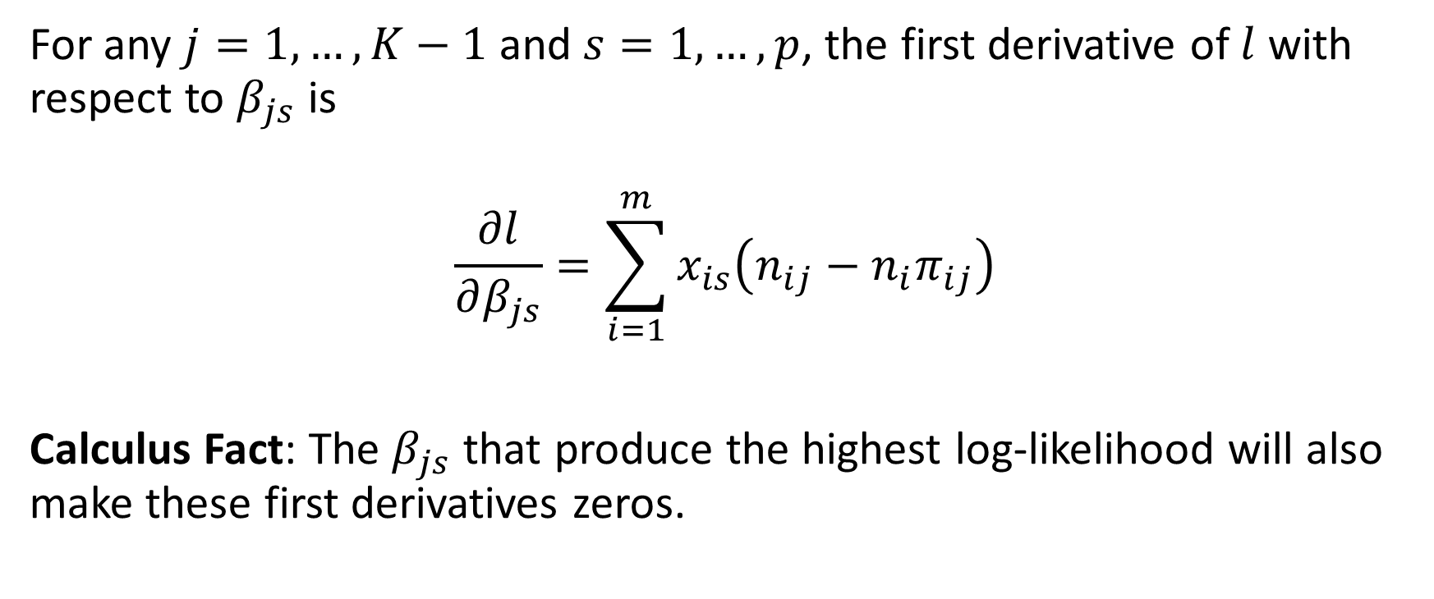
MNL: First Derivative of the Log-Likelihood Function
For any $j=1,…,K−1$ and $s=1,…,p$, the first derivative of $l$ with respect to $β_{js}$ is
$$\frac{∂l}{∂β_{js}}=\sum_{i=1}^{m}{x_{is}\left(n_{ij}−{n_{i}π}_{ij}\right)}$$
Calculus Fact: The $β_{js}$ that produce the highest log-likelihood will also make these first derivatives zeros.

Slide 27
MNL: Second Derivative of the Log-Likelihood Function
For any $j,l=1,…,K−1$ and $s,t=1,…,p$, the second derivative of $l$ with respect to $β_{js}$ and $β_{lt}$ is
$$\frac{∂^{2}l}{∂β_{js}∂β_{lt}}=−\sum_{i=1}^{m}{{n_{i}x}_{is}x_{it}π_{ij}\left(δ_{jl}−π_{il}\right)}$$
where $δ_{jl}=1$ if $j=l$, and 0 otherwise.
See the Machine Learning book for details

Slide 28
Matrix Representation of Gradient and Hessian
Stacked Parameter Vector
Dimension is $\left(K−1\right)p×1$
$$B=\left[\begin{matrix}β_{1} \\ ⋮ \\ β_{K−1}\end{matrix}\right]$$
Gradient Vector
Dimension is $\left(K−1\right)p×1$
$$∇l\left(B\right)≡{∂l}/{∂B}$$
Hessian Matrix
Dimension is $\left(K−1\right)p×\left(K−1\right)p$
$$H\left(β\right)≡{∂^{2}l}/{∂B∂B}$$

Slide 29
Newton-Raphson Algorithm
Calculate initial predicted probability $π^{\left(0\right)}$ and set $v=0$
Do iteration until converge
Calculate $∇l\left(B^{\left(ν\right)}\right)$ and $H\left(B^{\left(ν\right)}\right)$
Update parameter estimates $B^{\left(ν+1\right)}=B^{\left(ν\right)}−ξ{\left(H\left(B^{\left(ν\right)}\right)\right)}^{−1}\left(∇l\left(B^{\left(ν\right)}\right)\right)$
If necessary, adjust the stepping scalar $ξ>0$ to ensure that $l\left(B^{\left(ν+1\right)}\right)≥l\left(B^{\left(ν\right)}\right)$
Calculate the predicted probability $π^{\left(v+1\right)}$
Check if the iteration has converged or cannot continue due to errors

Slide 30
Step-Halving Adjustment
If the log-likelihood function decreases, i.e., $l\left(B^{\left(ν+1\right)}\right)<l\left(B^{\left(ν\right)}\right)$.
Adjust $ξ={\left(1/2\right)}^{u}$ for $u=0,…,U$ for a prespecified $U$. A common choice $U=7$ because ${\left(1/2\right)}^{7}=0.0078125<0.01$.
If the log-likelihood value still goes down after $U$ number of adjustments, then stop the iteration with a return code.
The main iteration will then decide the next step.

Slide 31
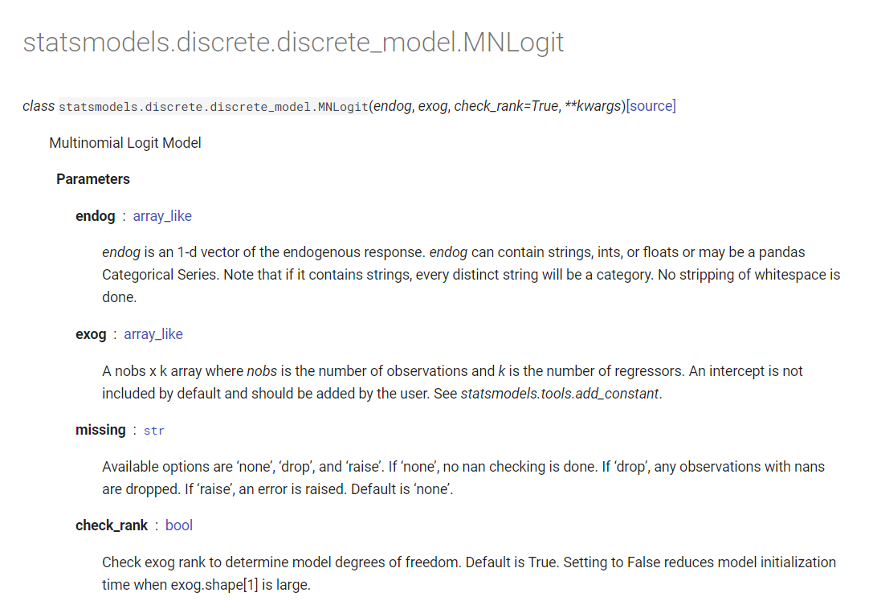
StatsModels 0.13.0 Python Library
https://www.statsmodels.org/dev/generated/statsmodels.discrete.discrete_model.MNLogit.html
StatsModels instantiates an object by first supplying the data. Then specifies the algorithm parameters at training time.
More appropriate for statistical modeling.

Slide 32
StatsModels 0.13.0 Python Library
Week 6 Cars Logistic.py
import numpy
import pandas
import sklearn.metrics as metrics
import statsmodels.api as stats
cars = pandas.read_csv('C:\\IIT\\Machine Learning\\Data\\cars.csv', delimiter=',')
# Specify Origin as a categorical variable
Origin = cars['Origin'].astype('category')
y = Origin
y_category = y.cat.categories
# Model is Origin = Intercept + DriveTrain + EngineSize + Horsepower + Length + Weight.
Origin = cars['Origin'].astype('category')
y = Origin
y_category = y.cat.categories
DriveTrain = cars[['DriveTrain']].astype('category')
X = pandas.get_dummies(DriveTrain)
X = X.join(cars[['EngineSize', 'Horsepower', 'Length', 'Weight']])
X = stats.add_constant(X, prepend=True)
logit = stats.MNLogit(y, X)
print("Name of Target Variable:", logit.endog_names)
print("Name(s) of Predictors:", logit.exog_names)
thisFit = logit.fit(method='newton', full_output = True, maxiter = 100, tol = 1e-8)
thisParameter = thisFit.params
print("Model Parameter Estimates:\n", thisFit.params)
print("Model Log-Likelihood Value:\n", logit.loglike(thisParameter.values))
y_predProb = thisFit.predict(X)
y_predict = pandas.to_numeric(y_predProb.idxmax(axis=1))
y_predictClass = y_category[y_predict]
y_confusion = metrics.confusion_matrix(y, y_predictClass)
print("Confusion Matrix (Row is True, Column is Predicted) = \n")
print(y_confusion)
y_accuracy = metrics.accuracy_score(y, y_predictClass)
print("Accuracy Score = ", y_accuracy)

Slide 33
MNL: Select Predictors
Forward Selection
Enter predictor into the model one at a time
Test if adding the predictor will improve the model goodness-of-fit
Backward Selection
Remove predictor from the model one at a time
Test if removing the predictor will not reduce the model goodness-of-fit
Start with a model without any predictor
Start with a model with ALL the predictors

Slide 34
MNL: Nested Models
Model 1
Model 0
Model 0 is nested in Model 1
Predictors in Model 0 are also predictors in Model 1
Model 1 should have better goodness-of-fit than Model 0
If Model 1 has the “same” goodness-of-fit as Model 0, then the predictors in Model 1 which are NOT in Model 0 do not help make Model 1 better.

Slide 35
MNL: Nested Models
Model 1
Model 0
1. Model 1
2. Model 0
1. Model 0
2. Model 1

Slide 36
MNL: Deviance Test
Model 0
Let $l_{0}$ be the log-likelihood value
Let $m_{0}$ be the number of free parameters (excluding the linear dependent)
Model 1
Let $l_{1}$ be the log-likelihood value
Let $m_{1}$ be the number of free parameters (excluding the linear dependent)
The Deviance Test
Test statistic as $G^{2}=2\left(l_{1}−l_{0}\right)≥0$
The degree of freedom $df=m_{1}−m_{0}>0$
$G^{2}$ has a Chi-square distribution with $m_{1}−m_{0}$ degrees of freedom

Slide 37
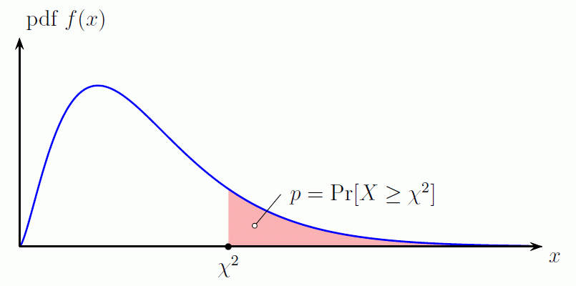
MNL: Deviance Test
Calculate the significance value of the $G^{2}$ statistic using the Chi-square distribution with $m_{1}−m_{0}$ degrees of freedom
Forward: If the significance value is less than a preset level, say 5%, then we will conclude that adding that predictor will improve the overall model goodness-of-fit.
Backward: If the significance value is greater than a preset level, say 5%, then we will conclude that removing that predictor will not reduce the overall model goodness-of-fit.

Slide 38
MNL: Deviance Test Decision
Forward Selection
Consider only predictors whose significances are less than 5%
Enter the predictor which has the lowest significance value into the current model
Backward Selection
Consider only predictors whose significances are greater than 5%
Remove the predictor which has the highest significance value from the current model

Slide 39
Chi-Square Distribution
Let $X$ be a continuous random variable that takes values from this open interval $(0,∞)$.
The probability density function is $f\left(x\right)=\frac{1}{2^{m/2}Γ\left(m/2\right)}x^{\frac{m}{2} −1}e^{−\frac{x}{2}}$
$m>0$ is the degrees of freedom
$Γ\left(u\right)$ is the complete Gamma function
The probability $Pr\left(X<x\right)=\int_{0}^{x}{f\left(u\right) du}$ (i.e., no closed-form).
The mean is $m$ and the variance is $2m$.
When $m=2$, the Chi-square distribution is an Exponential distribution with $λ=1/2$.

Slide 40
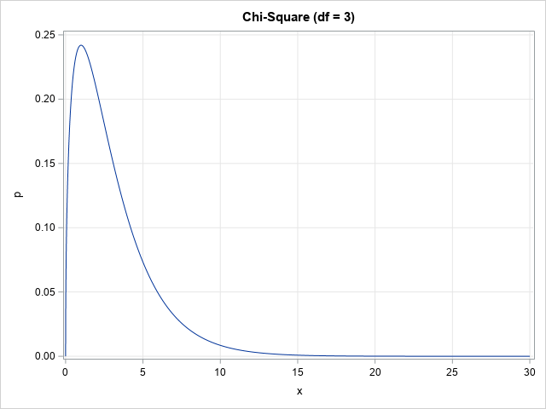
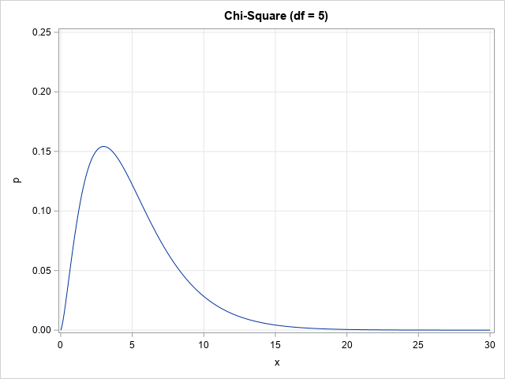
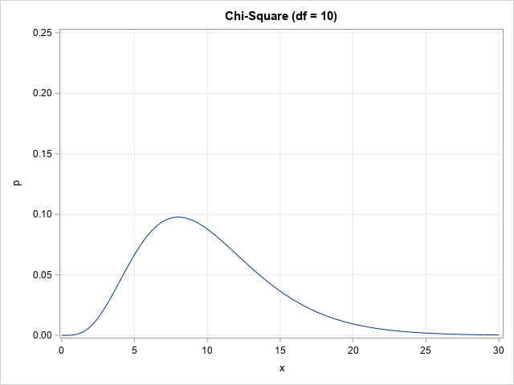
Chi-Square Distribution
Python Function | Density | Distribution | Significance | Quantile | Random Number
scipy.stats.chi2 | .pdf() | .cdf() | .sf() | .ppf() | .rvs()

Slide 41
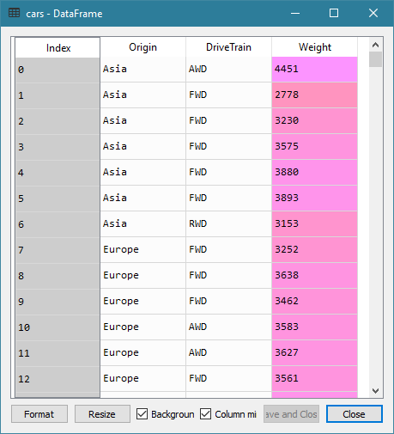
MNL: 2004 Cars Data
Data
2004 Cars Data: cars.csv.
428 observations
Origin: Manufacturer Origin, nominal
DriveTrain: Type of Drive Train, (AWD, FWD, RWD), categorical
Weight: Vehicle Weight, interval
Target
Predictor

Slide 42
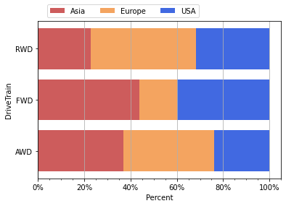
MNL: 2004 Cars Data
Week 6 Cars Logistic Forward Selection.py
RWD vehicles are made more often by European car manufacturers than Asian and USA car manufacturers
FWD vehicles are made more often by Asian and USA car manufacturers than European car manufacturer
AWD vehicles are made equally often by Asian and European car manufacturers

Slide 43
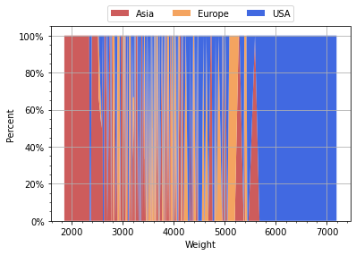
MNL: 2004 Cars Data
If a vehicle’s weight is above 5,800 pounds, then the car manufacturer must be in USA
If a vehicle’s weight is less than 2,200 pounds, then the car manufacturer must be in Asia.

Slide 44
MNL: Forward Selection
Model 0: Origin = Intercept
In other words, it is the Intercept Only model
Consider Model 1: Origin = Intercept + <predictor> <predictor> = DriveTrain, Weight
Calculate the Deviance test statistic and then use the Chi-square significance value to determine if the <predictor> will improve model goodness-of-fit

Slide 45
SWEEP Operator
Reference: https://www.jstor.org/stable/2347983?origin=crossref&seq=1
def SWEEPOperator (pDim, inputM, tol):
# pDim: dimension of matrix inputM, integer greater than one
# inputM: a square and symmetric matrix, numpy array
# tol: singularity tolerance, positive real
aliasParam = []
nonAliasParam = []
A = numpy.copy(inputM)
diagA = numpy.diagonal(inputM)
for k in range(pDim):
Akk = A[k,k]
if (Akk >= (tol * diagA[k])):
nonAliasParam.append(k)
ANext = A - numpy.outer(A[:, k], A[k, :]) / Akk
ANext[:, k] = A[:, k] / Akk
ANext[k, :] = ANext[:, k]
ANext[k, k] = -1.0 / Akk
else:
aliasParam.append(k)
ANext[:, k] = 0.0 * A[:, k]
ANext[k, :] = ANext[:, k]
A = ANext
return (A, aliasParam, nonAliasParam)
Week 6 Cars Logistic Forward Selection.py

Slide 46
Train Model Function
def build_mnlogit (fullX, y):
# Find the non-redundant columns in the design matrix fullX
nFullParam = fullX.shape[1]
XtX = numpy.transpose(fullX).dot(fullX)
invXtX, aliasParam, nonAliasParam
= SWEEPOperator(pDim = nFullParam, inputM = XtX, tol = 1e-7)
# Build a multinomial logistic model
X = fullX.iloc[:, list(nonAliasParam)]
logit = stats.MNLogit(y, X)
thisFit = logit.fit(method = 'newton', maxiter = 1000, gtol = 1e-6,
full_output = True, disp = True)
thisParameter = thisFit.params
thisLLK = logit.loglike(thisParameter.values)
# The number of free parameters
nYCat = thisFit.J
thisDF = len(nonAliasParam) * (nYCat - 1)
# Return model statistics
return (thisLLK, thisDF, thisParameter, thisFit)
Alternative Way
thisLLK = thisFit.llf
Week 6 Cars Logistic Forward Selection.py

Slide 47
Select Mode as Reference Category
SWEEP Operator takes last category as reference
# Reorder the categories in ascending order of frequencies
# Create dummy indicators for the categorical input feature
catFreq = trainData[catName].value_counts()
catFreq = catFreq.sort_values(ascending = True)
newCat = catFreq.index
u = trainData[catName].astype('category')
xCat = pandas.get_dummies(u.cat.reorder_categories(newCat))
# Column for the interval input feature
xInt = trainData[intName]
# Reorder the categories in descending order of frequencies of the target field
catFreq = trainData[yName].value_counts()
catFreq = catFreq.sort_values(ascending = False)
newCat = catFreq.index
u = trainData[yName].astype('category')
y = u.cat.reorder_categories(newCat)
print('Target Categories:\n', y.cat.categories)
MNLOGIT function takes first category as reference

Slide 48
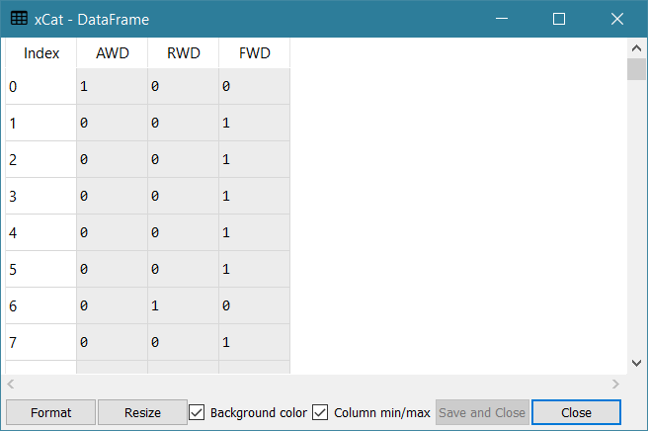
Select Mode as Reference Category
--- Frequency of Origin ---
Asia 158
USA 147
Europe 123
Name: Origin, dtype: int64
--- Frequency of DriveTrain ---
FWD 226
RWD 110
AWD 92
Name: DriveTrain, dtype: int64
Target Categories:
Index(['Asia', 'USA', 'Europe'], dtype='object')

Slide 49
MNL: Forward Selection
# Train a Logistic Regression model using the Forward Selection method
devianceTable = pandas.DataFrame()
u = pandas.DataFrame()
# Step 0: Intercept only model
u = y.isnull()
designX = pandas.DataFrame(u.where(u, 1)).rename(columns = {yName: "const"})
LLK0, DF0, fullParams0, thisFit = build_mnlogit (designX, y)
devianceTable = devianceTable.append([[0, 'Intercept', DF0, LLK0, None, None, None]])

Slide 50
MNL: Forward Selection
# Step 1.1: Intercept + 'DriveTrain'
designX = xCat
designX = stats.add_constant(designX, prepend = True)
LLK1, DF1, fullParams1, thisFit = build_mnlogit (designX, y)
testDev = 2.0 * (LLK1 - LLK0)
testDF = DF1 - DF0
testPValue = scipy.stats.chi2.sf(testDev, testDF)
devianceTable = devianceTable.append([[1.1, 'Intercept + DriveTrain',
DF1, LLK1, testDev, testDF, testPValue]])
# Step 1.2: Intercept + 'Weight'
designX = xInt
designX = stats.add_constant(designX, prepend = True)
LLK1, DF1, fullParams1, thisFit = build_mnlogit (designX, y)
testDev = 2.0 * (LLK1 - LLK0)
testDF = DF1 - DF0
testPValue = scipy.stats.chi2.sf(testDev, testDF)
devianceTable = devianceTable.append([[1.2, 'Intercept + Weight', DF1, LLK1, testDev, testDF, testPValue]])

Slide 51
MNL: Forward Selection
# Step 2.1: Intercept + 'DriveTrain' + 'Weight'
# Note: Since Pandas will not append a non-categorical index (as in xInt) to a categorical index
# (as in xCat) but will append in another direction, so we append xCat to xInt instead.
# The model is still the same.
designX = xInt
designX = designX.join(xCat)
designX = stats.add_constant(designX, prepend = True)
LLK1, DF1, fullParams1, thisFit = build_mnlogit (designX, y)
testDev = 2.0 * (LLK1 - LLK0)
testDF = DF1 - DF0
testPValue = scipy.stats.chi2.sf(testDev, testDF)
devianceTable = devianceTable.append([[2.1, 'Intercept + Weight + DriveTrain', DF1, LLK1, testDev, testDF, testPValue]])
devianceTable = devianceTable.rename(columns = {0:'Sequence', 1:'Model Specification',
2:'Number of Free Parameters', 3:'Log-Likelihood',
4:'Deviance', 5:'Degree of Freedom', 6:'Significance'})

Slide 52
MNL: Forward Selection
Sequence | Model Specification | Number of Free Parameters | Log-Likelihood | Deviance | Degree of Freedom | Significance
0 | Intercept | 2 | -467.9224
1.1 | Intercept + DriveTrain | 6 | -447.1785 | 41.4879 | 4 | 2.1299E-08
1.2 | Intercept + Weight | 4 | -451.4704 | 32.9041 | 2 | 7.1610E-08
Since all Chi-Square Significance values are less than 0.05, both DriveTrain and Weight both can improve model goodness-of-fit.
Since DriveTrain’s Chi-Square Significance value is smallest, we will first enter DriveTrain into the model.
Step 1 produces Model 1 which is Intercept + DriveTrain

Slide 53
MNL: Forward Selection
Sequence | Model Specification | Number of Free Parameters | Log-Likelihood | Deviance | Degree of Freedom | Significance
1 | Intercept + DriveTrain | 6 | -447.1785
2.1 | Intercept + DriveTrain + Weight | 8 | -426.7579 | 40.8412 | 2 | 1.3535E-09
Since the Chi-Square Significance from adding Weight to Model 1 is less than 0.05, we conclude that Weight can improve model goodness-of-fit.
Therefore, we enter Weight into the model.
Step 2 produces Model 2 which is Intercept + Weight + DriveTrain
Since there are no more predictors for consideration, the Forward Selection stops.

Slide 54
MNL: Backward Selection
Week 6 Cars Logistic Backward Selection.py
Model 0: Origin = Intercept + DriveTrain + Weight
In other words, it is the Full Main Effect model
Consider Model 1: Origin = Intercept + DriveTrain + Weight - <predictor> <predictor> = DriveTrain, Weight
Calculate the Deviance test statistic and then use the Chi-square significance value to determine if the <predictor> will decrease model goodness-of-fit

Slide 55
MNL: Backward Selection
Index | Model Form | Number of Free Parameters | Log-Likelihood | Deviance | Degrees of Freedom | Chi-Square Significance
0 | Intercept + DriveTrain + Weight | 8 | -426.7579
1.1 | Intercept + Weight | 4 | -451.4704 | 49.4250 | 4 | 4.7604e-10
1.2 | Intercept + DriveTrain | 6 | -447.1785 | 40.8412 | 2 | 1.3535e-09
Since all Chi-Square Significance values are not greater than 0.05, removing either DriveTrain or Weight both will reduce model goodness-of-fit.
Therefore, no predictors can be removed.
The Backward Selection stops at Model 0: Intercept + DriveTrain + Weight

Slide 56
MNL: All Possible Selection
Suppose we have plenty of computing resources and time is not an issue
Suppose we want a model with the best goodness-of-fit
Then we can consider the All-Possible Selection

Slide 57
MNL: All Possible Selection
Suppose we are satisfied with models with only main effects (i.e., exclude interactions of predictors)
Suppose we have $r≥1$ predictors
Consider the model with no predictor (i.e., Intercept Only)
Consider models with only one predictors
Consider models with only $s<r$ predictors
…
Consider the model with all $r$ predictors

Slide 58
MNL: All Possible Selection
The Number of models considered
$$\left({r \atop 0}\right)+\left({r \atop 1}\right)+\left({r \atop 2}\right)+…+\left({r \atop s}\right)+…+\left({r \atop r}\right)=2^{r}$$
$$r$$ | 2 | 3 | 4 | 5 | 6 | 7 | 8 | 9 | 10 | 11 | 12
$$2^{r}$$ | 4 | 8 | 16 | 32 | 64 | 128 | 256 | 512 | 1024 | 2048 | 4096

Slide 59
MNL: All Possible Selection
import statsmodels.api as smodel
from itertools import combinations
catFeature = ['DriveTrain', 'Type', 'Cylinders']
contFeature = ['Horsepower', 'MPG_City', 'MPG_Highway', 'Weight', 'Wheelbase', 'Length']
allFeature = catFeature + contFeature
allCombResult = pandas.DataFrame()
allComb = []
for r in range(len(allFeature)+1):
allComb = allComb + list(combinations(allFeature, r))

Slide 60
Choose Between Non-Nested Models
Suppose we need to choose between two models that are not nested, can we choose the model that has a higher log-likelihood value?
Since the more parameters (or higher degree of freedom) in a model, the higher the model’s log-likelihood value.
If we choose the model that has a higher log-likelihood, then we will always choose the model that also has more parameters.
Do we have other alternatives?

Slide 61
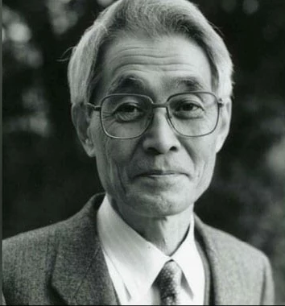
Akaike Information Criterion
An alternative is to add a penalty to the log-likelihood for having many parameters in a model.
The more parameters in a model, the bigger the penalty.
Japanese statistician Hirotugu Akaike (1927 – 2009) suggested the Akaike Information Criterion (AIC).
$AIC=−2\hat{l}+2p$ where
$\hat{l}$ is the maximized log-likelihood value of the model
$p$ is the number of free parameters in the model.
Prefer a model that has a lower AIC value.

Slide 62
Bayesian Information Criterion
Gideon E. Schwarz (1933 – 2007) suggested the Bayesian Information Criterion (BIC).
$BIC=−2\hat{l}+p\log_{e}\left(n\right)$ where
$\hat{l}$ is the maximized log-likelihood value of the model
$p$ is the number of free parameters in the model
$n$ is the number of observations used in training the model
Handle situations when the models are trained on data with different number of observations.
Prefer a model that has a lower BIC value.

Slide 63
MNL: 2004 Cars Data
Target Variable: Origin
Nominal Predictors: DriveTrain, Type, and Cylinders
Interval Predictors: Horsepower, MPG_City, MPG_Highway, Weight, Wheelbase, Length
DriveTrain | Frequency
AWD | 92
FWD | 226
RWD | 108
Type | Frequency
Hybrid | 3
SUV | 60
Sedan | 262
Sports | 47
Truck | 24
Wagon | 30
Cylinders | Frequency
3 | 1
4 | 136
5 | 7
6 | 190
8 | 87
10 | 2
12 | 3
Origin | Frequency
Asia | 156
Europe | 123
USA | 147

Slide 64
MNL: 2004 Cars Data
Target Variable: Origin
Nominal Predictors: DriveTrain, Type, and Cylinders
Interval Predictors: Horsepower, MPG_City, MPG_Highway, Weight, Wheelbase, Length
Origin | Horsepower | MPG_City | MPG_Highway | Weight | Wheelbase | Length
Asia | 190.70 | 22.01 | 28.27 | 3319.32 | 105.89 | 182.82
Europe | 251.89 | 18.73 | 26.01 | 3680.72 | 106.45 | 181.85
USA | 212.82 | 19.07 | 26.01 | 3769.95 | 112.02 | 193.95

Slide 65
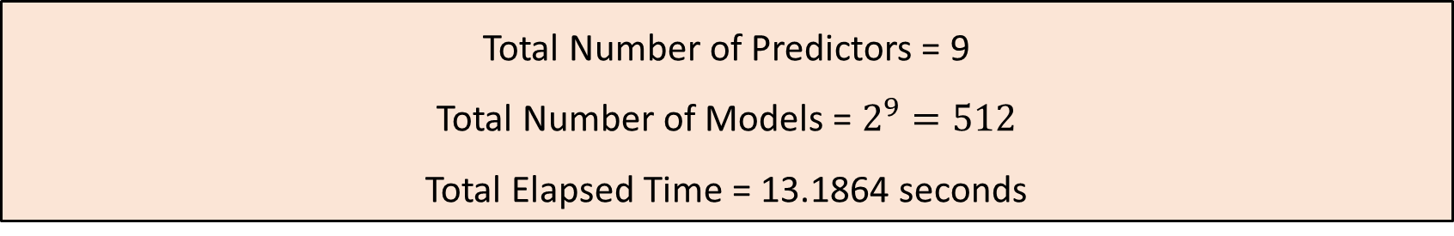
MNL: 2004 Cars Data
Target Variable: Origin
Nominal Predictors: DriveTrain, Type, and Cylinders
Interval Predictors: Horsepower, MPG_City, MPG_Highway, Weight, Wheelbase, Length
Total Number of Predictors = 9
Total Number of Models = $2^{9}=512$
Total Elapsed Time = 13.1864 seconds

Slide 66
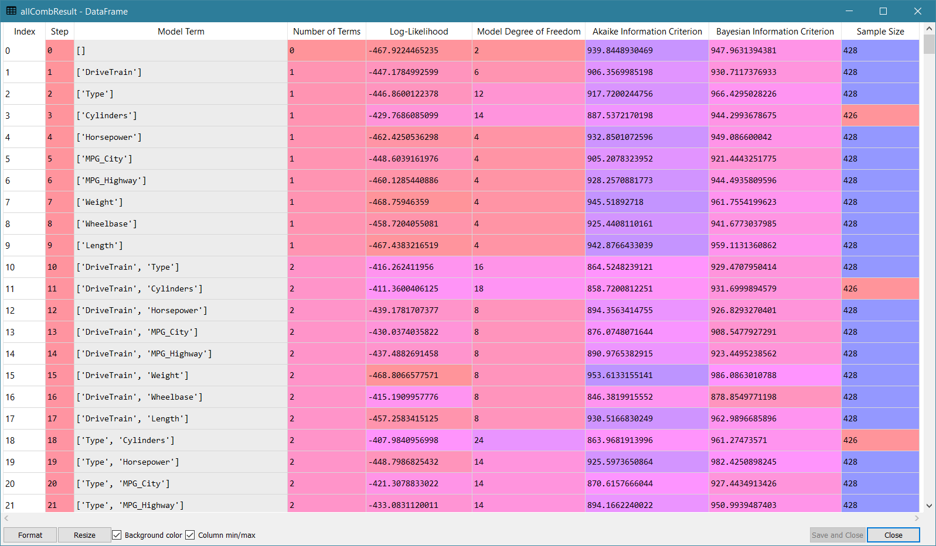
MNL: 2004 Cars Data

Slide 67
MNL: 2004 Cars Data
Criterion | Highest Log-Likelihood | Lowest AIC | Lowest BIC
Model Term | ['DriveTrain', 'Type', 'Cylinders', 'Horsepower', 'MPG_City', 'MPG_Highway', 'Length'] | ['DriveTrain', 'Cylinders', 'Horsepower', 'MPG_City', 'MPG_Highway', 'Length'] | ['DriveTrain', 'Horsepower', 'MPG_City', 'MPG_Highway', 'Length']
Number of Terms | 7 | 6 | 5
Log-Likelihood | -337.33 | -342.05 | -367.08
Model Degree of Freedom | 36 | 26 | 14
Akaike Information Criterion | 746.65 | 736.09 | 762.15
Bayesian Information Criterion | 892.61 | 841.51 | 818.98
Sample Size | 426 | 426 | 428

Slide 68
Lecture Recap
We described the theory of the multinomial logistic regression algorithm.
We described the maximum likelihood estimation.
We used the statsmodels to train a multinomial logistic regression model.
We learned to select predictors using the Forward, the Backward, and the All-Possible methods.

Slide 69

Assignment 3
Due at 11:59 pm on Monday, March 8, 2021
Submit your answers as a PDF file
Submit your Python codes as .py files, otherwise liable for 50% deduction
Submit your answers no more than two times
Only grade the most recently submitted answers

